Slide 1

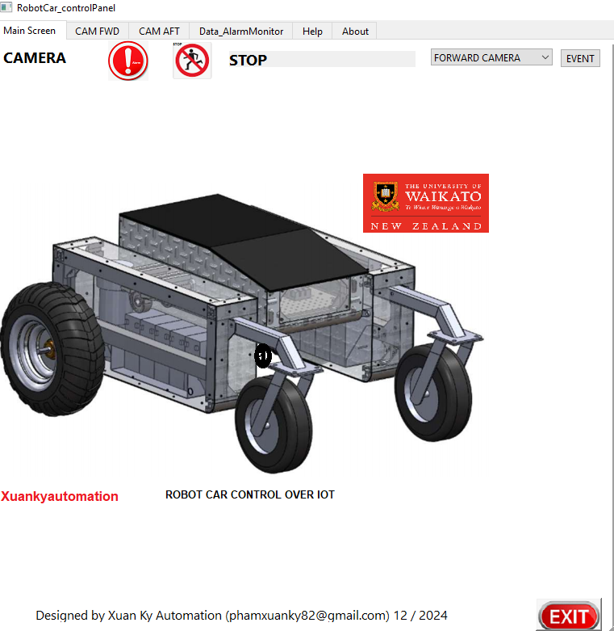
ROBOT CAR CONTROL Revolutionizing Automation with Smart Robotics
COMBINATION OF IOT WITH AI TECHNOLOGY
http://waikatorobotcar.great-site.net
http://robotcarwaikato.great-site.net
https://robotcarwaikato.great-site.net
By: Xuan Ky Pham
ID: 1649932
University Supervisors
Doctor: Melanie Ooi
Date 6/5/2025

Slide 2
Introduction
What is IoT in Robotics?
The Internet of Things (IoT) enables devices to connect, communicate, and make decisions based on data.
In robotics, IoT allows for real-time data exchange, remote control, and automation.
Why Robot Cars with IoT?
Used in autonomous delivery systems, self-driving cars, and smart logistics.
The objective of the Presentation
Explain how IoT enhances robotic vehicles.
Discuss architecture, operation procedure, tools for development, challenges, and future improvements.

Slide 3
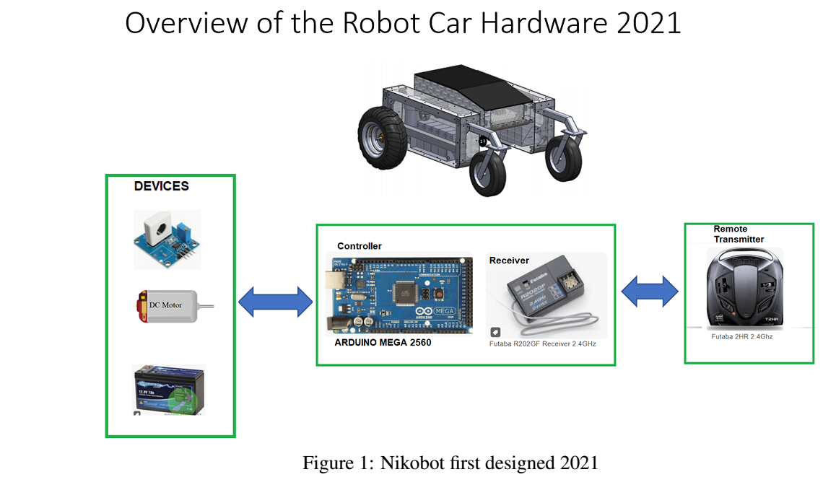
Nikobot 2021 Hardware

Slide 4
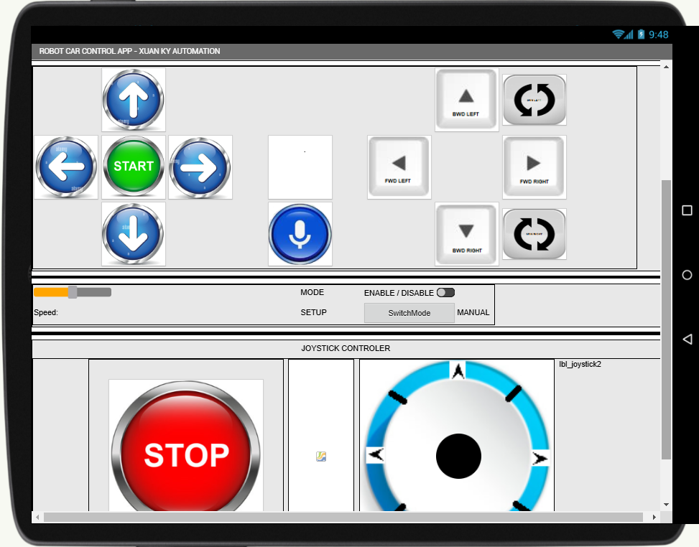
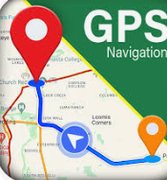
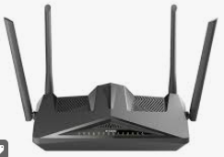
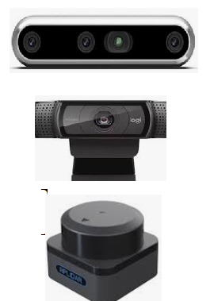
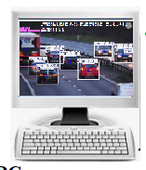
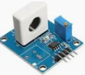
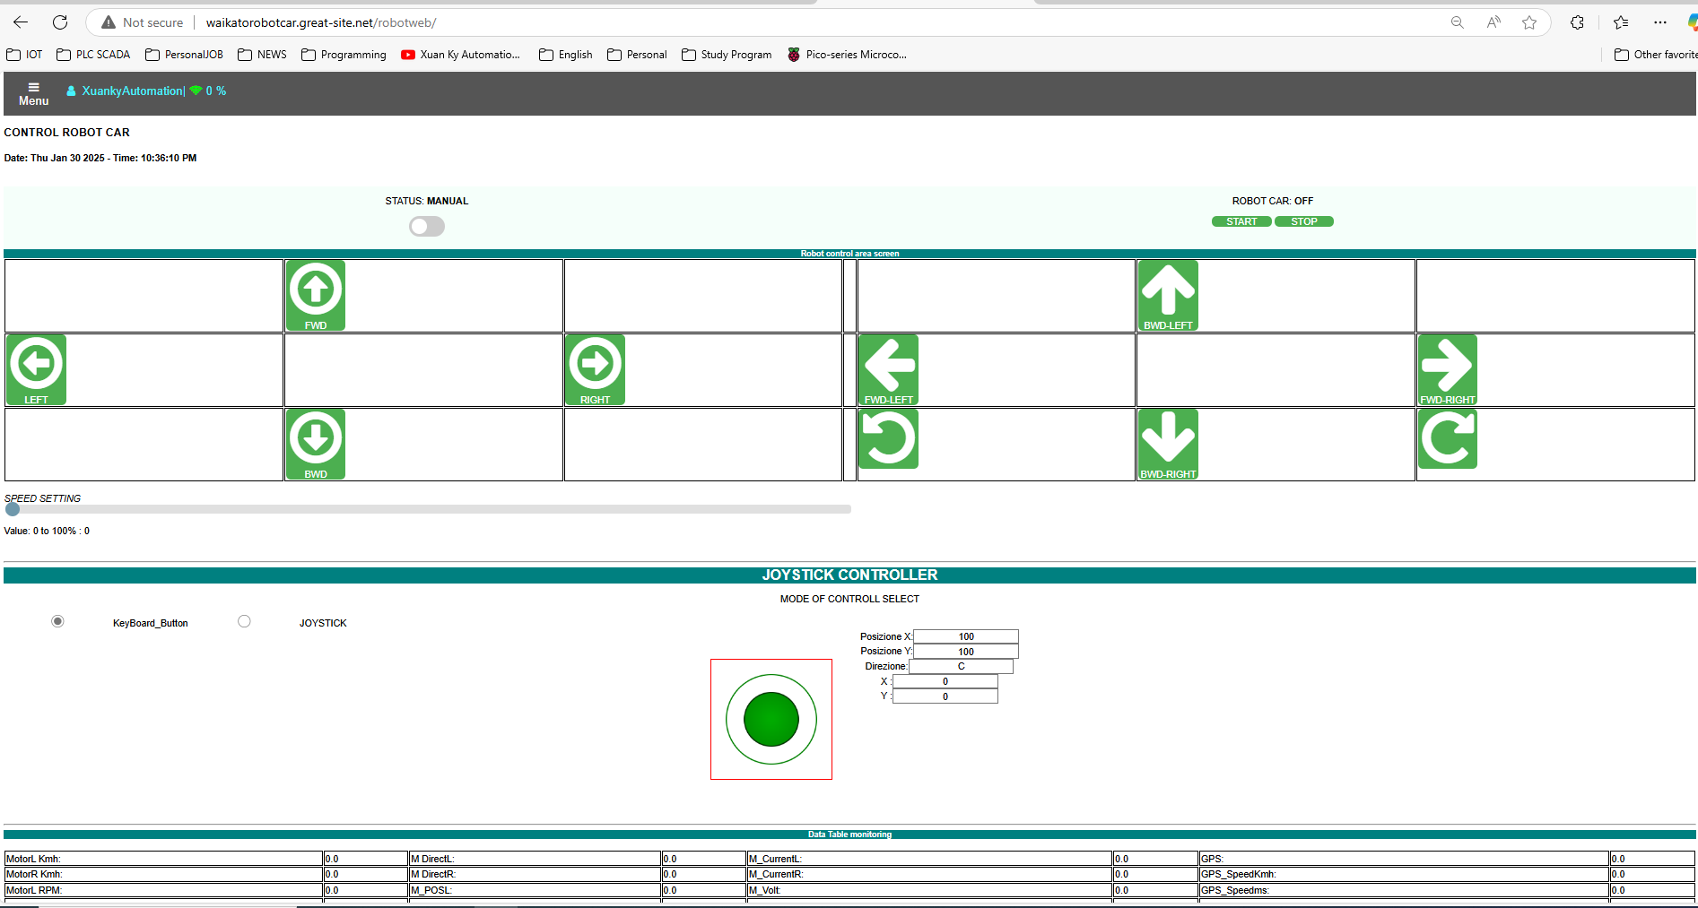
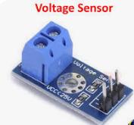
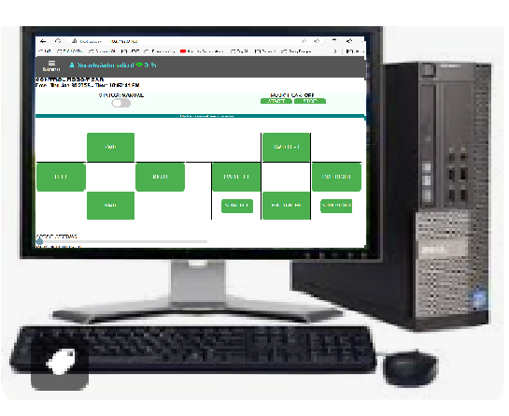
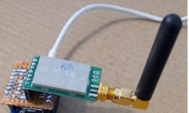
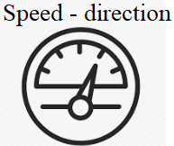
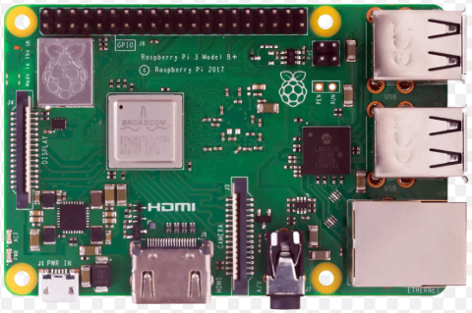
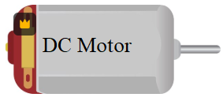
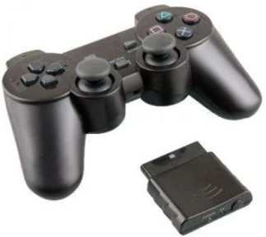
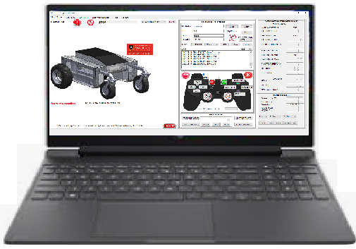
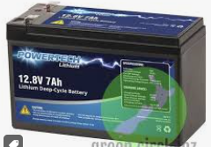
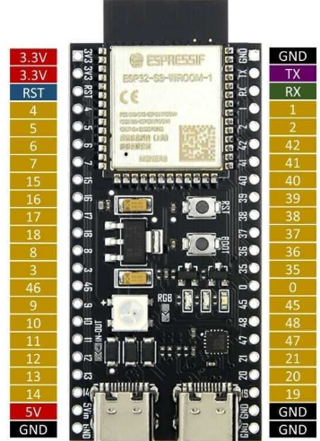
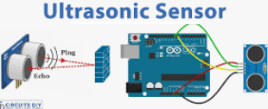
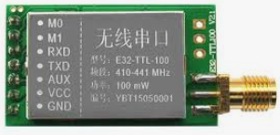
Overview of the Robot Car Hardware
2.Controller
1. Python Flask webserver
2. Rplidar, Camera
3. Python Yolo V10
4.HMI
1.Devices
3.Communication
Local MQTT Broker
Apache Webserver
Webserver
MQTT Client
WebSocket Server

Slide 5
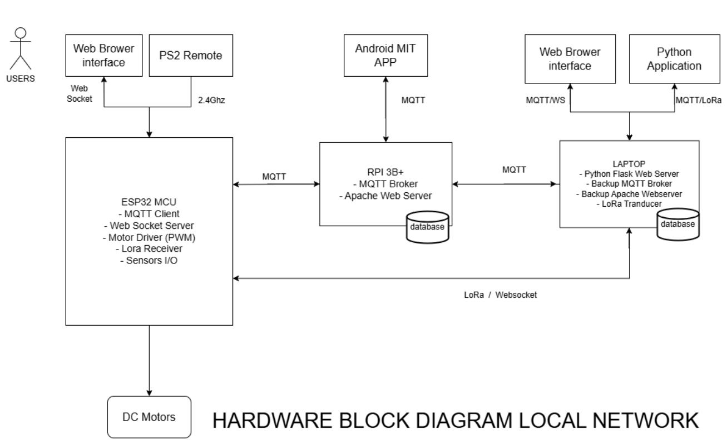

Slide 6
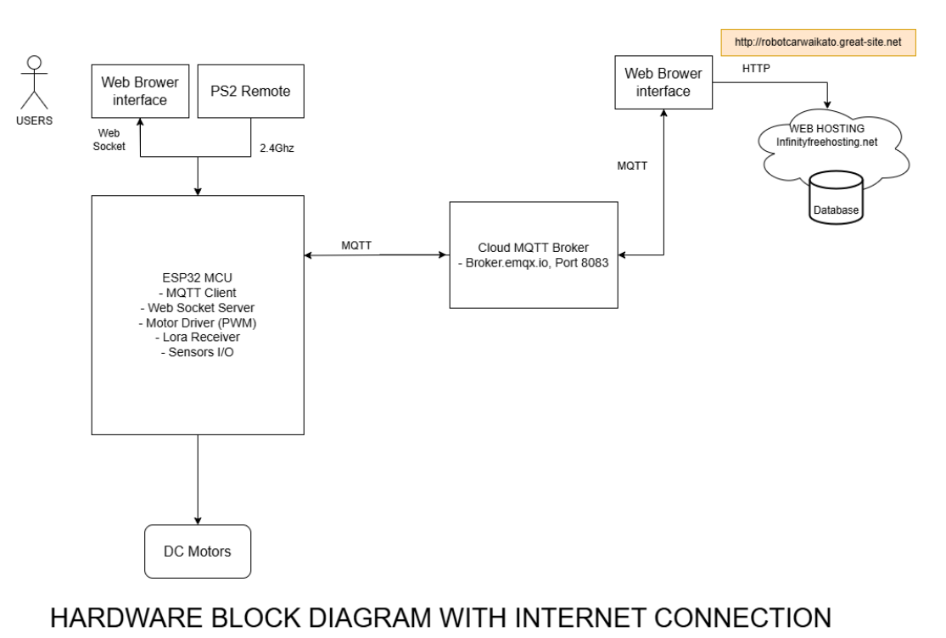

Slide 7
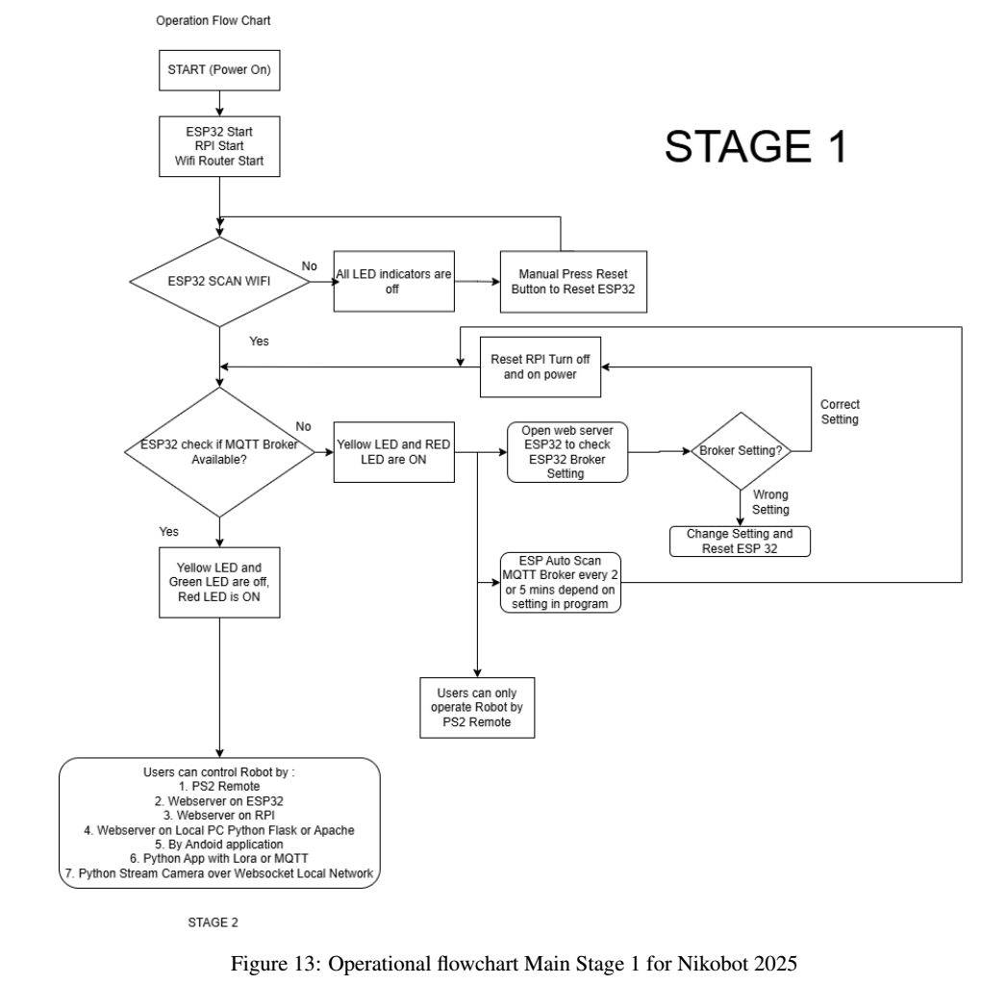
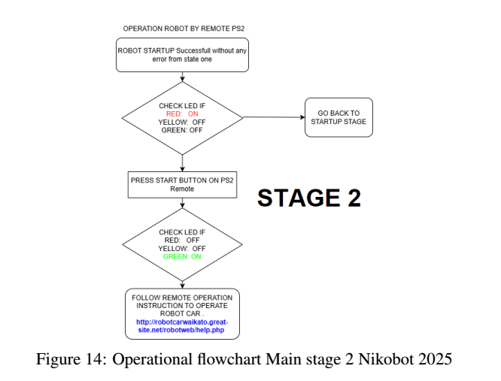
Operation flow chart stage 1

Slide 8
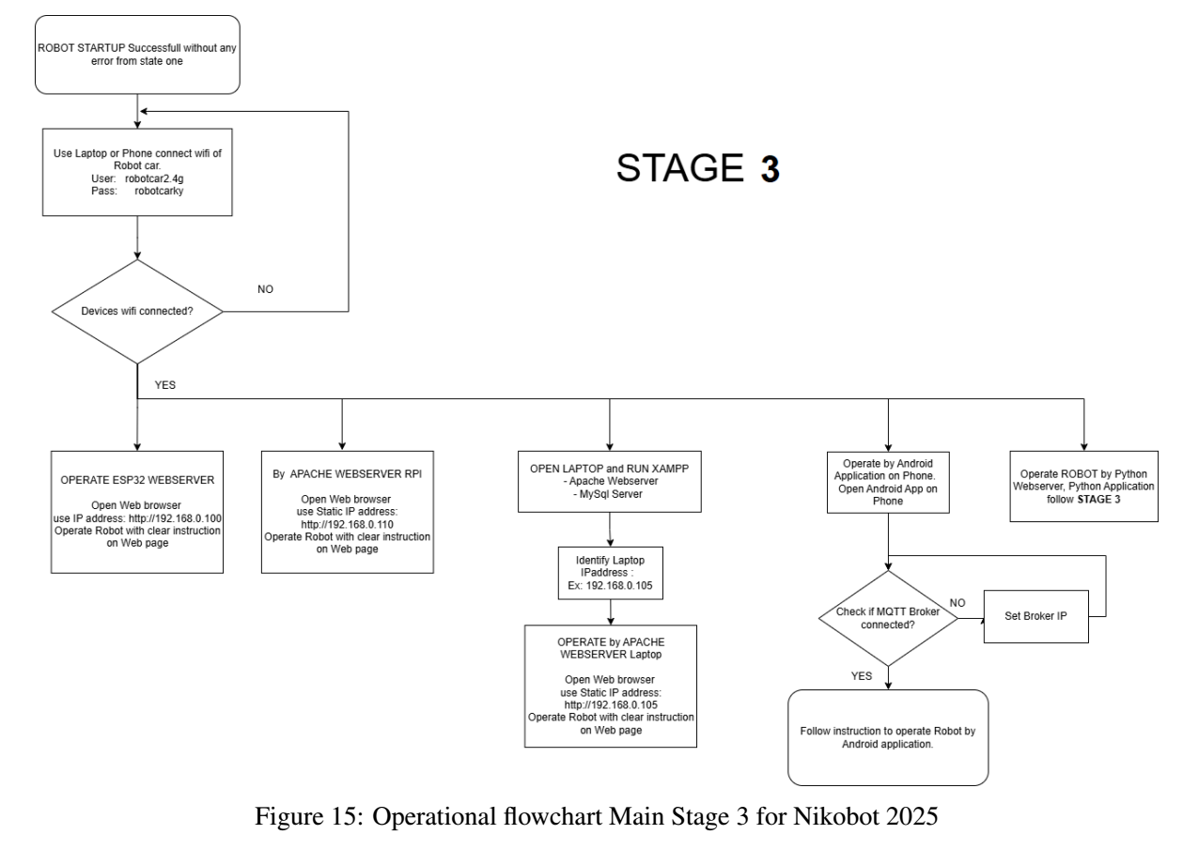

Slide 9
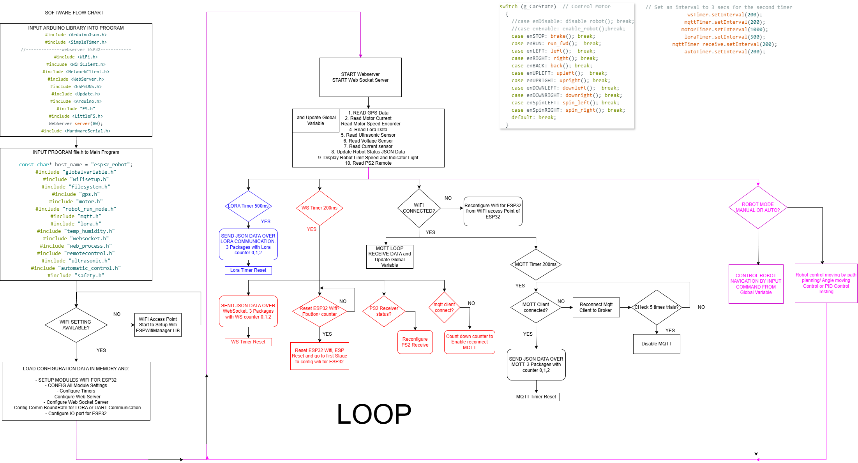

Slide 10
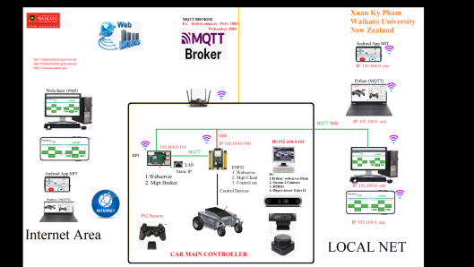
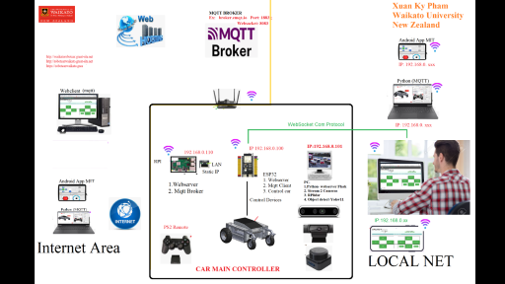
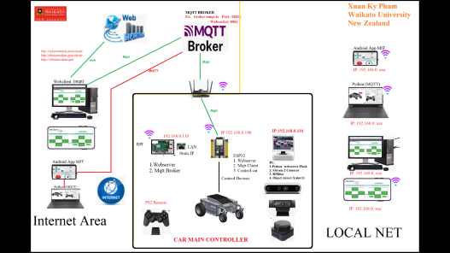
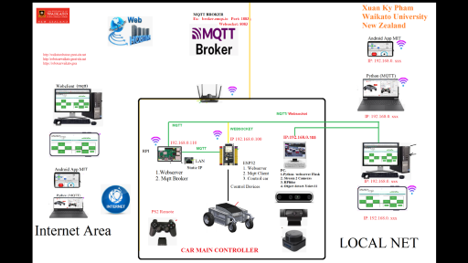
CONTROL ROBOT REMOTELY BY WEBSERVER
WEBSERVER ON ESP32
WEBSERVER ON RPI
WEBSERVER ON LOCAL PC
WEBSERVER ON INTERNET

Slide 11
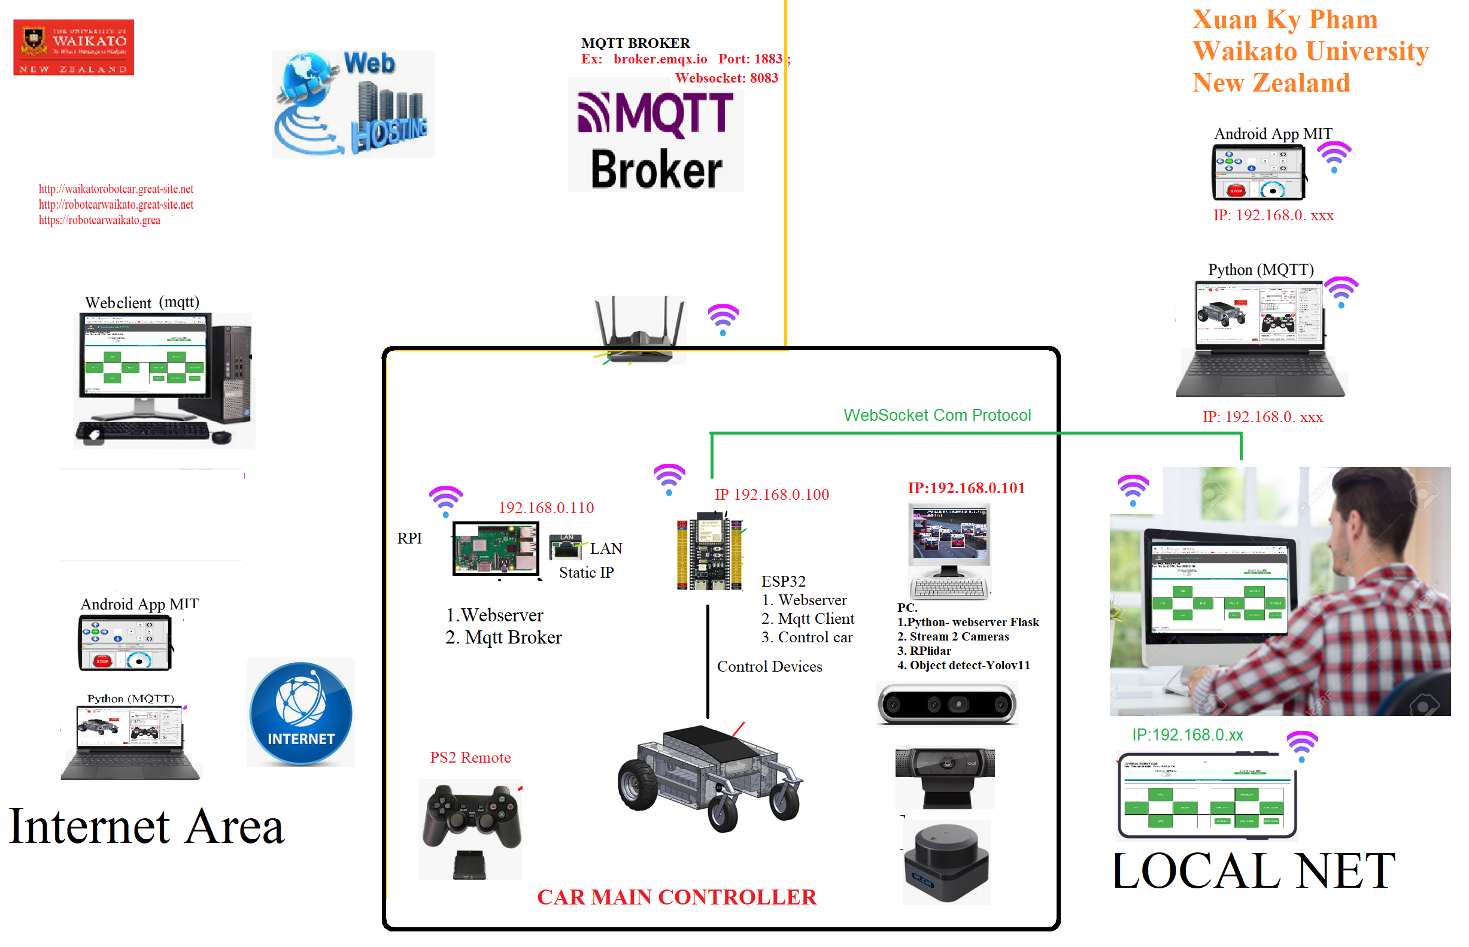
CONTROL CAR USING WEBSERVER ON ESP32

Slide 12
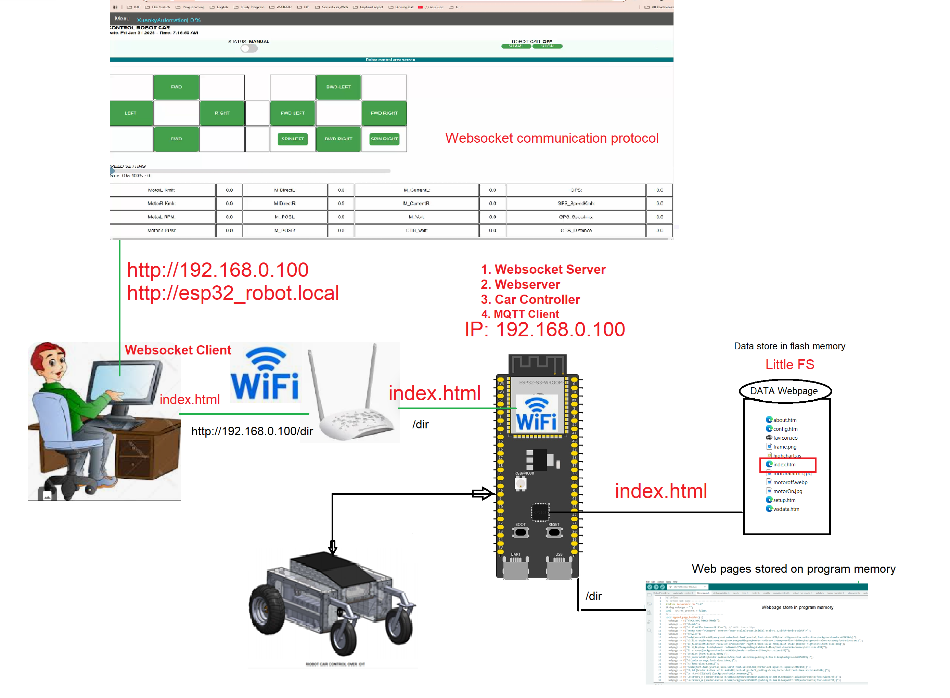

Slide 13
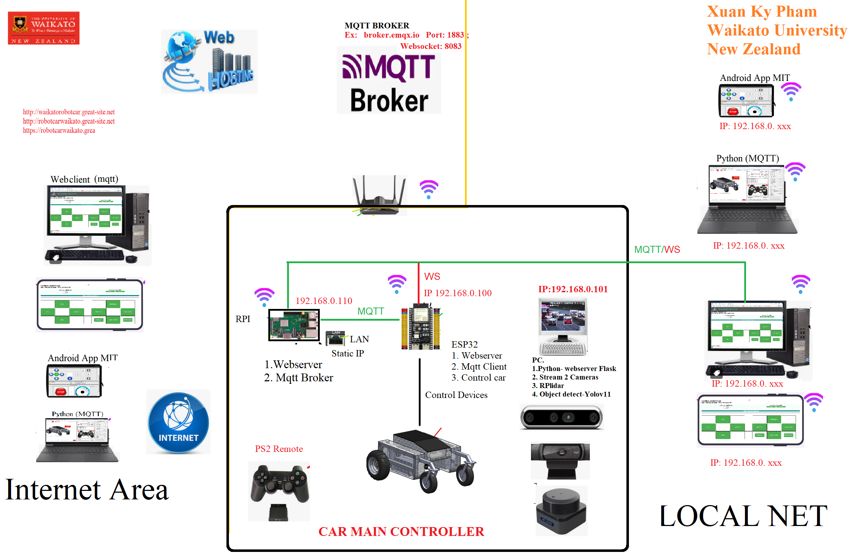
CONTROL CAR USING WEBSERVER ON RPI

Slide 14
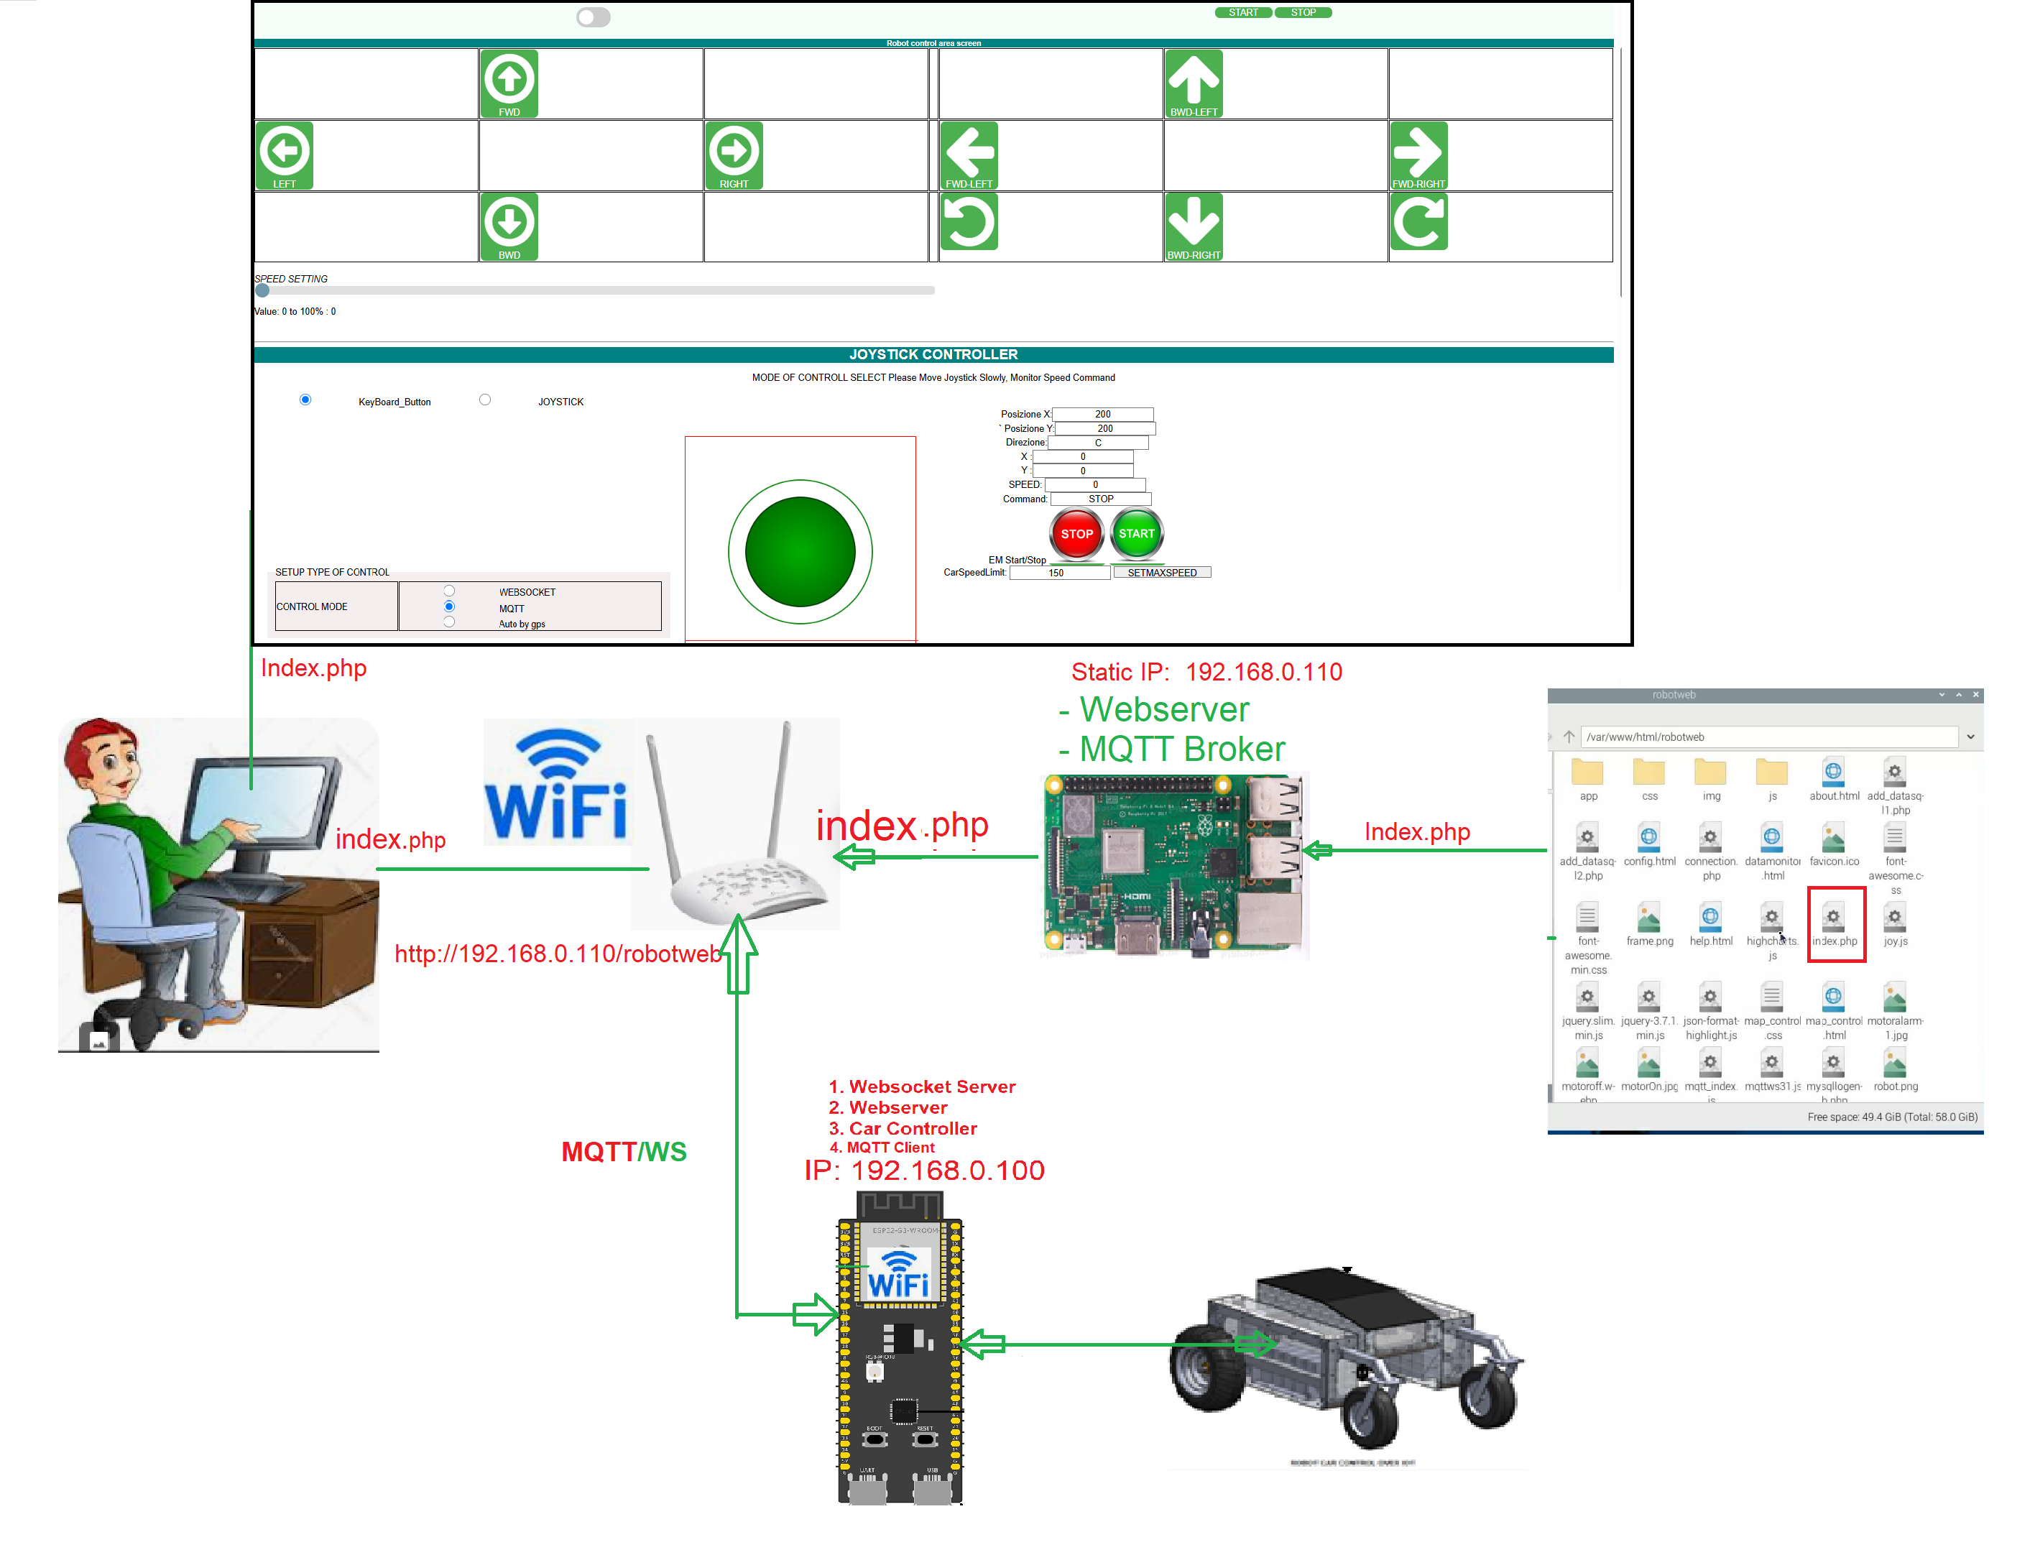

Slide 15
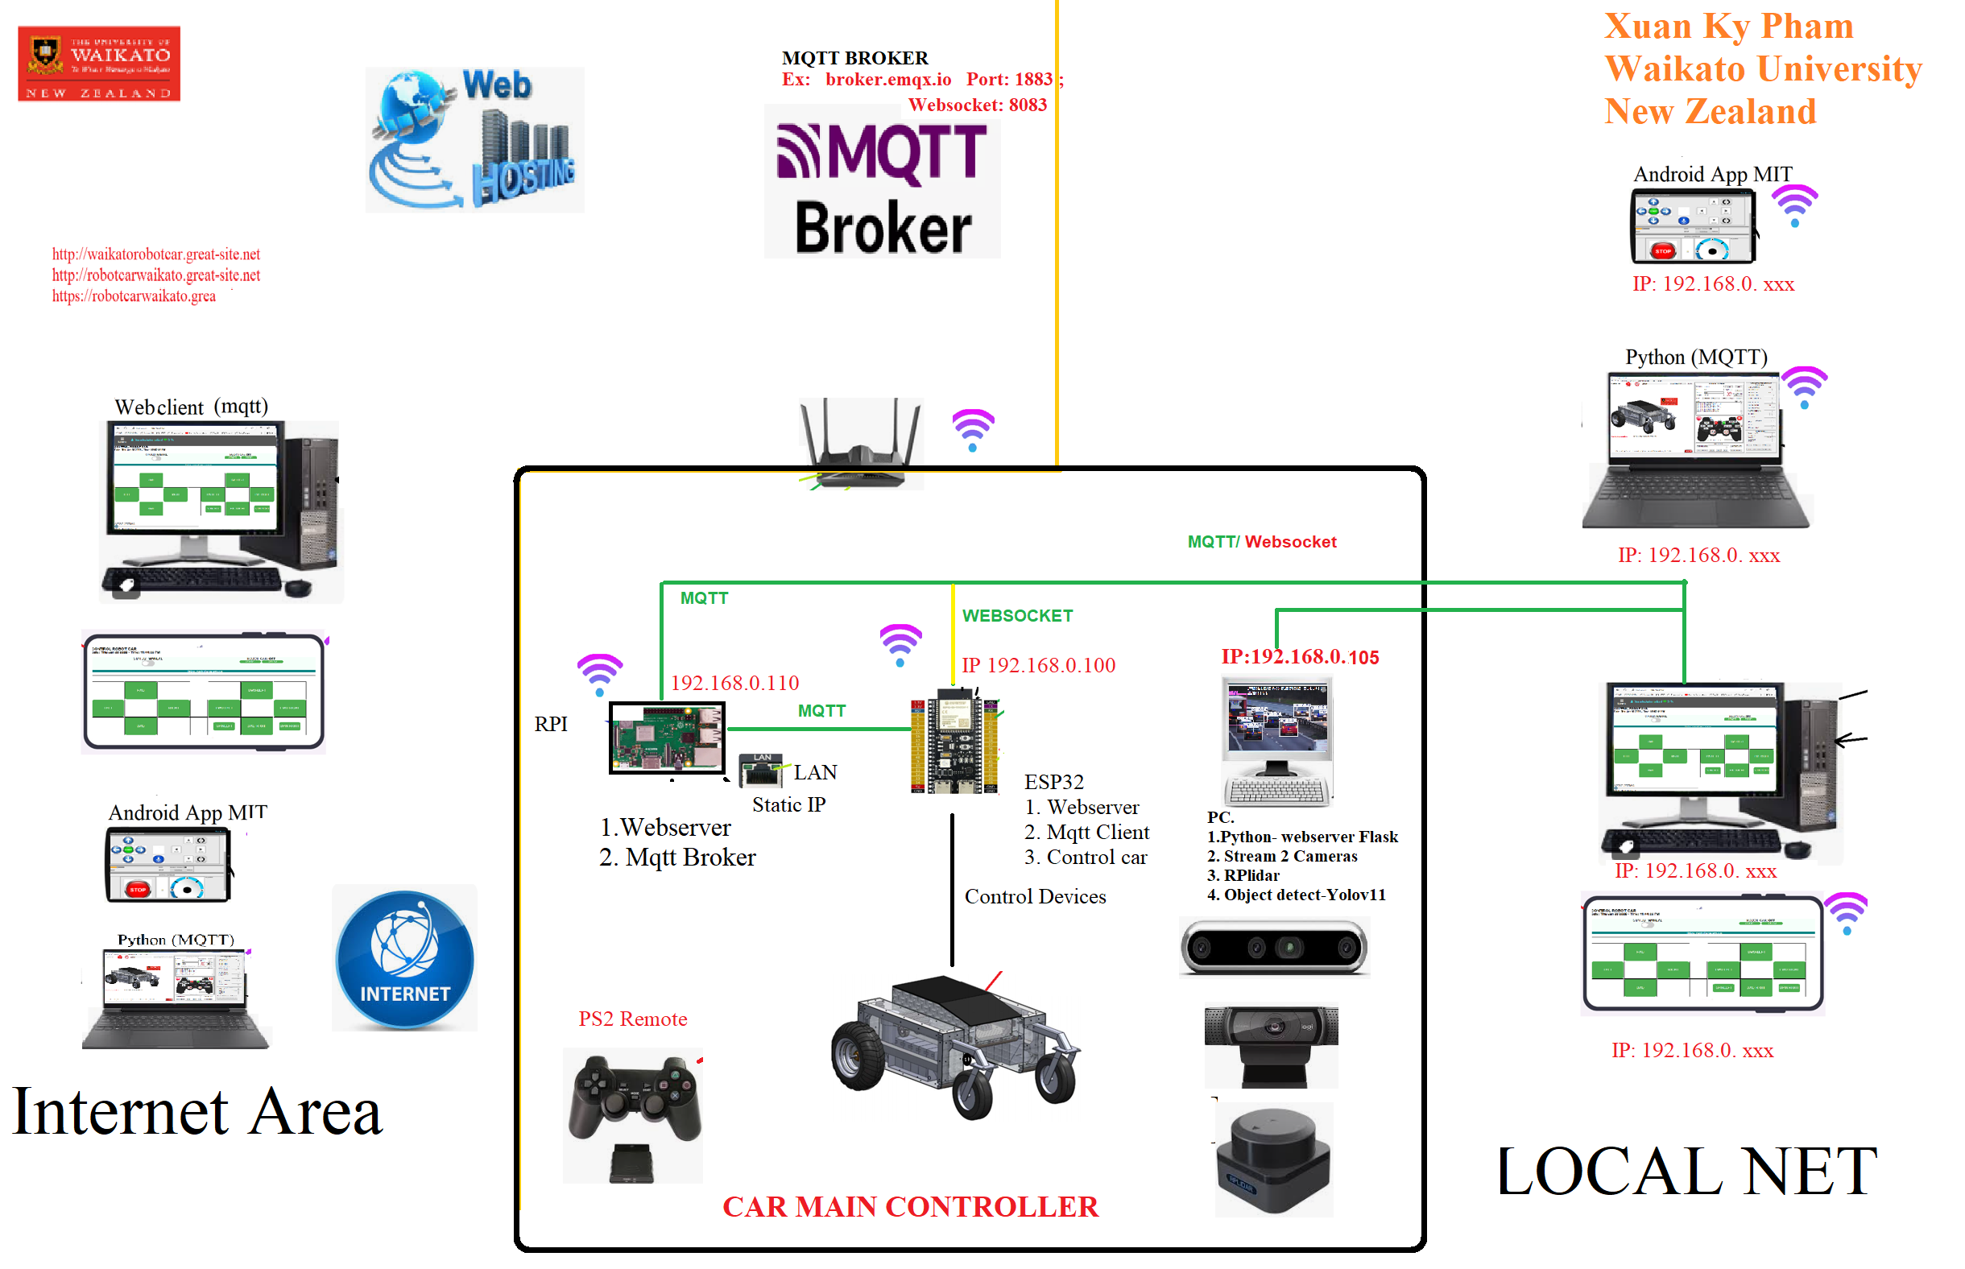
CONTROL CAR USING WEBSERVER ON LOCAL PC

Slide 16
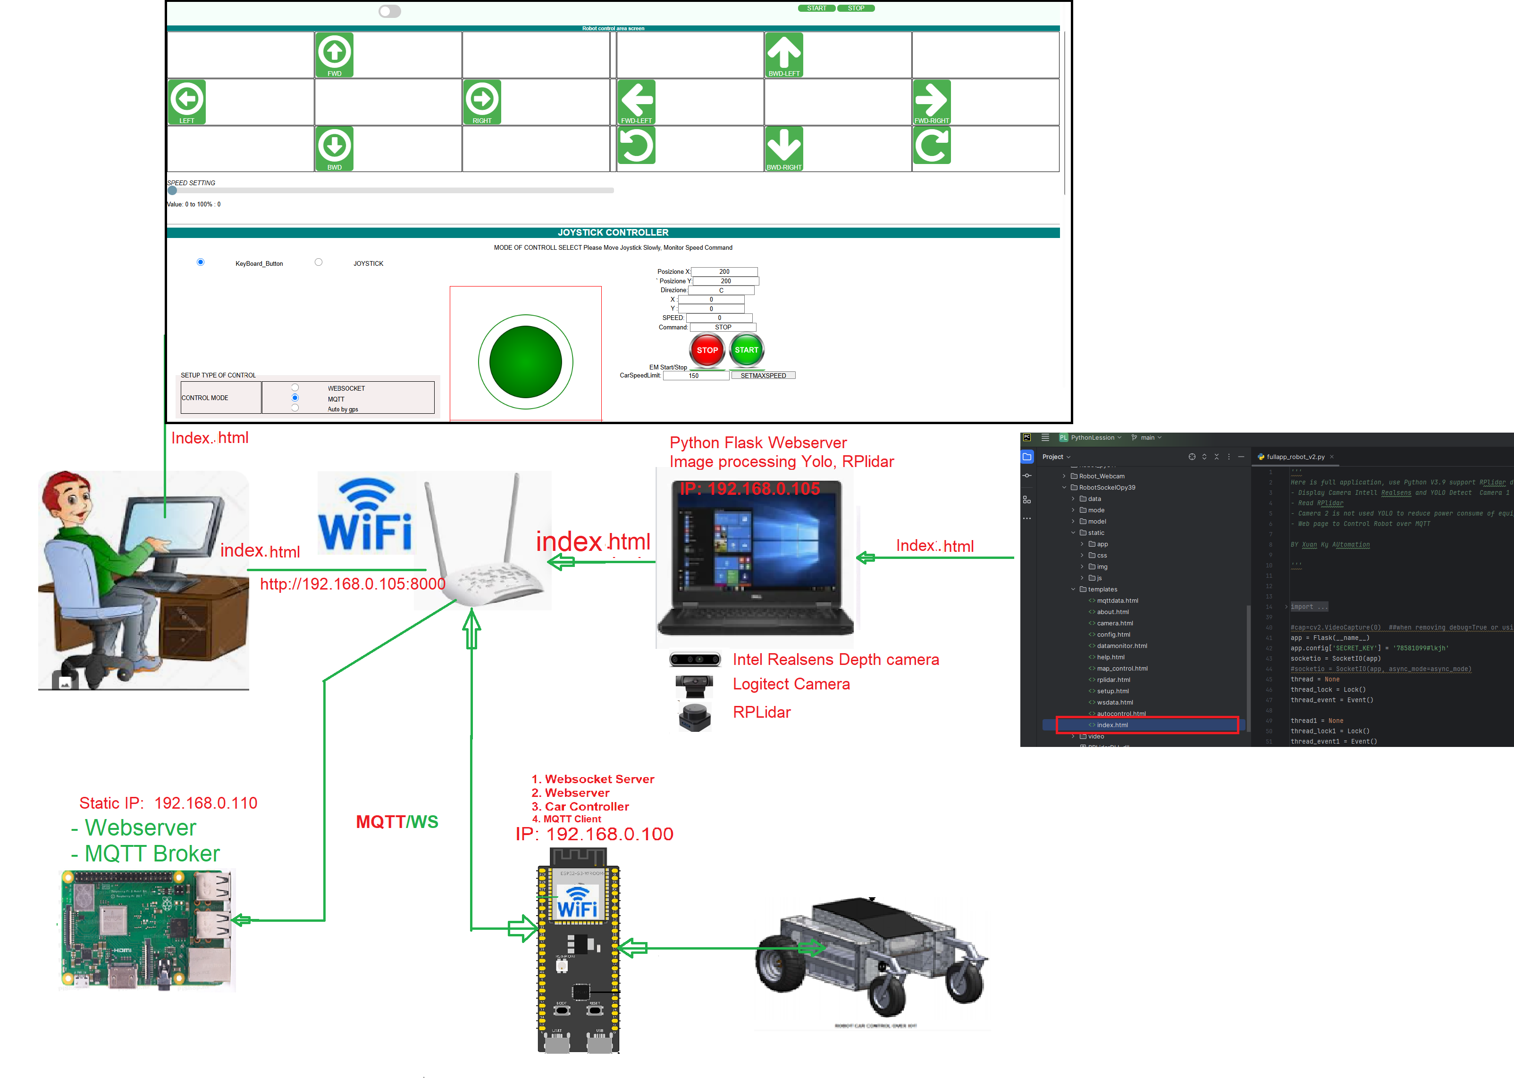

Slide 17
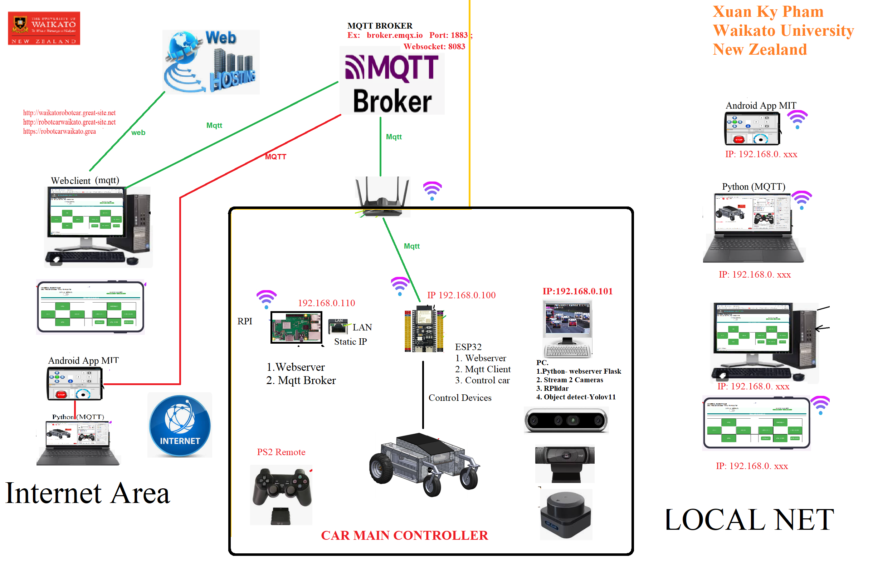
CONTROL CAR USING WEBSERVER ON INTERNET

Slide 18
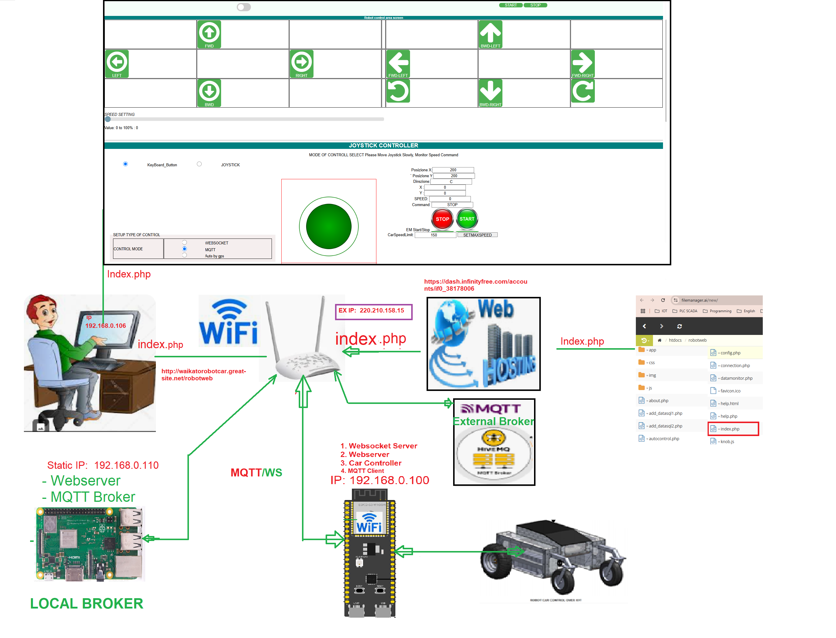

Slide 19
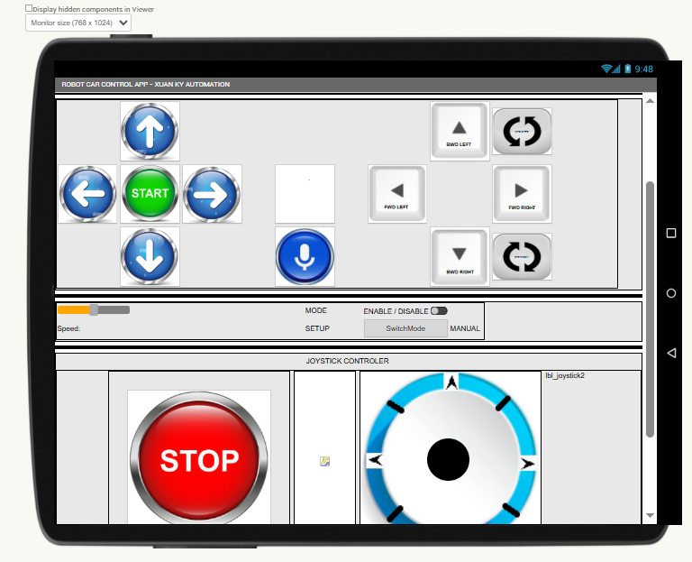
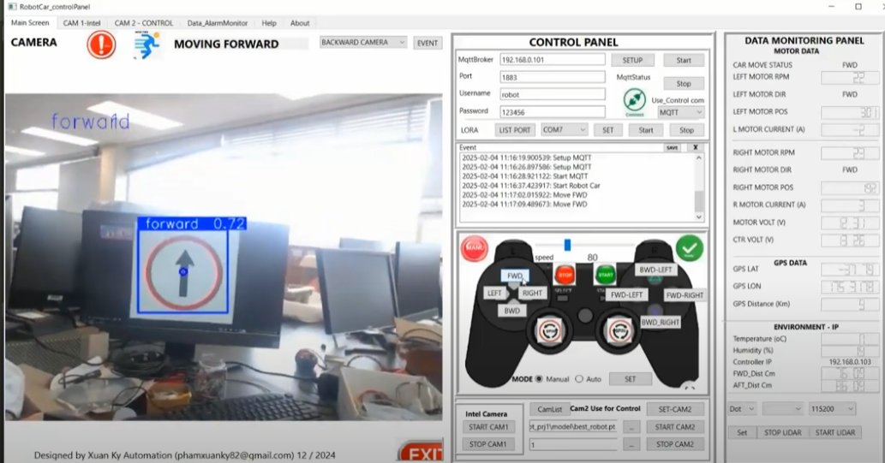
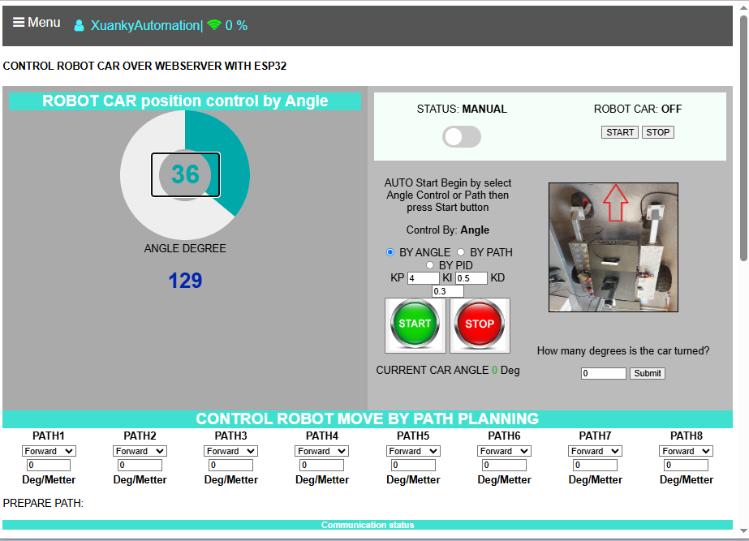
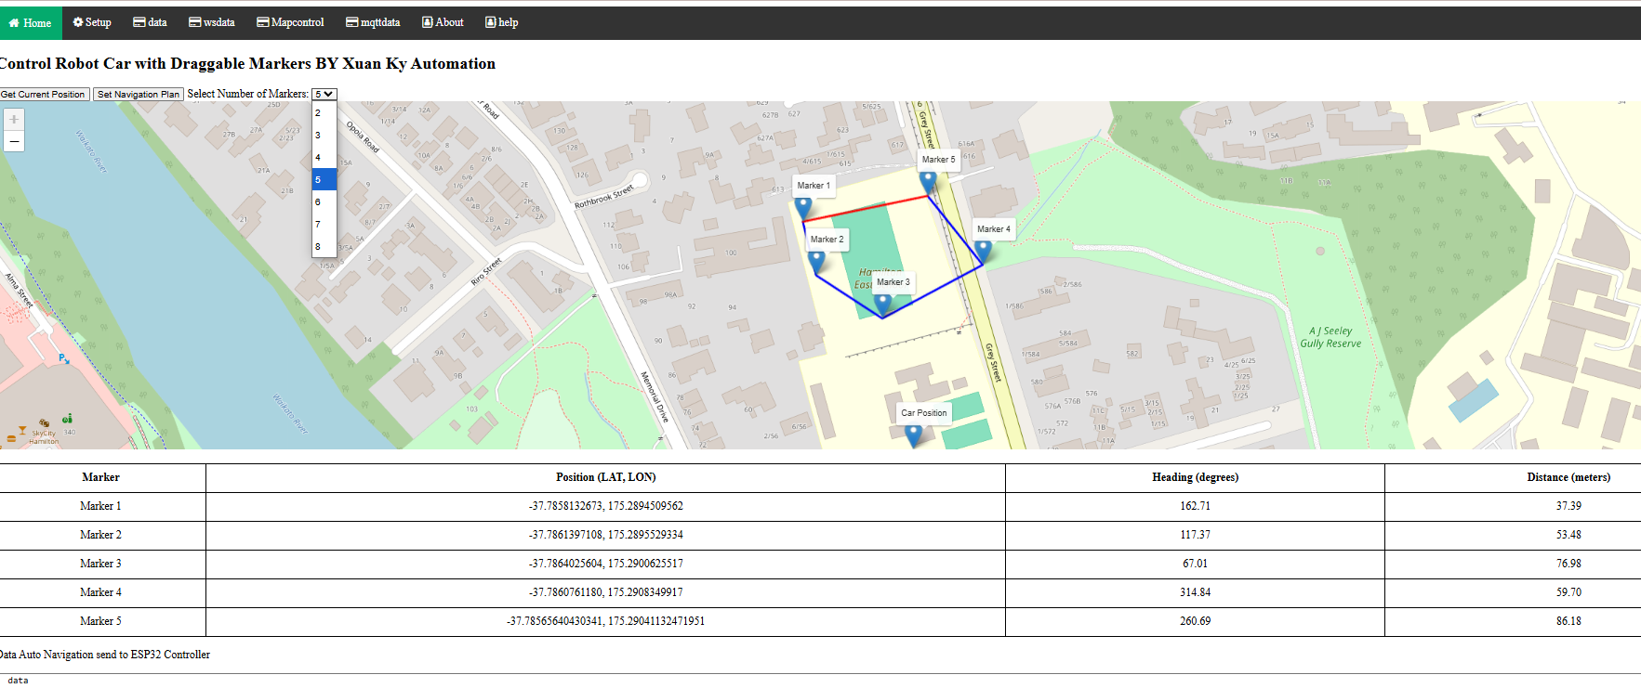
OTHERS MQTT APPLICATION
MQTT Android App
MQTT Image Process Yolo V10/YoloV11
7
8
MQTT Position Control
MQTT Automatic by path planning
10
9

Slide 20
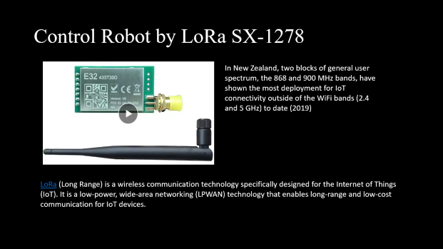
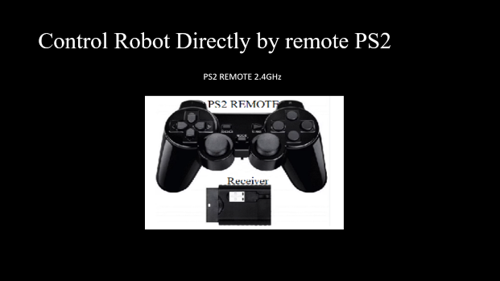
Backup Communication and Control

Slide 21
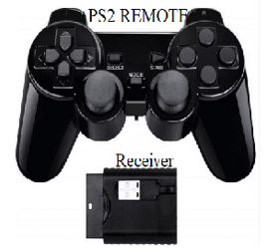
Control Robot Directly by remote PS2
PS2 REMOTE 2.4GHz

Slide 22
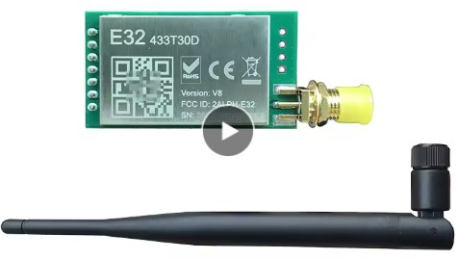
Control Robot by LoRa SX-1278
In New Zealand, two blocks of general user spectrum, the 868 and 900 MHz bands, have shown the most deployment for IoT connectivity outside of the WiFi bands (2.4 and 5 GHz) to date (2019)
LoRa (Long Range) is a wireless communication technology specifically designed for the Internet of Things (IoT). It is a low-power, wide-area networking (LPWAN) technology that enables long-range and low-cost communication for IoT devices.

Slide 23
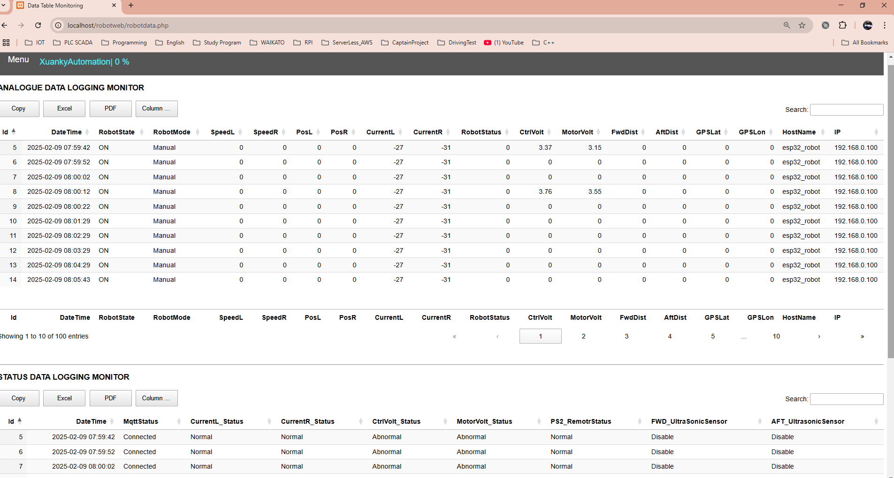
DATA LOGGING BY MY SQL ON RPI OR PC USE PHP

Slide 24
Challenges & Limitations
Connectivity Issues: Weak Wi-Fi or mobile networks can affect real-time control.
Sensor Accuracy: GPS drift and ultrasonic sensor noise can impact performance.
Battery Life: IoT components consume more power, requiring efficient energy management.
Environmental Factors: Sunlight interference with reflectance sensors, and road surface issues.
The car's weight, including the battery, also affects the power duration.
Increase safety for unexpected access web to control the car, we need to improve the security
Automatic operation by path planning needs to find an Algorithm to control car move

Slide 25
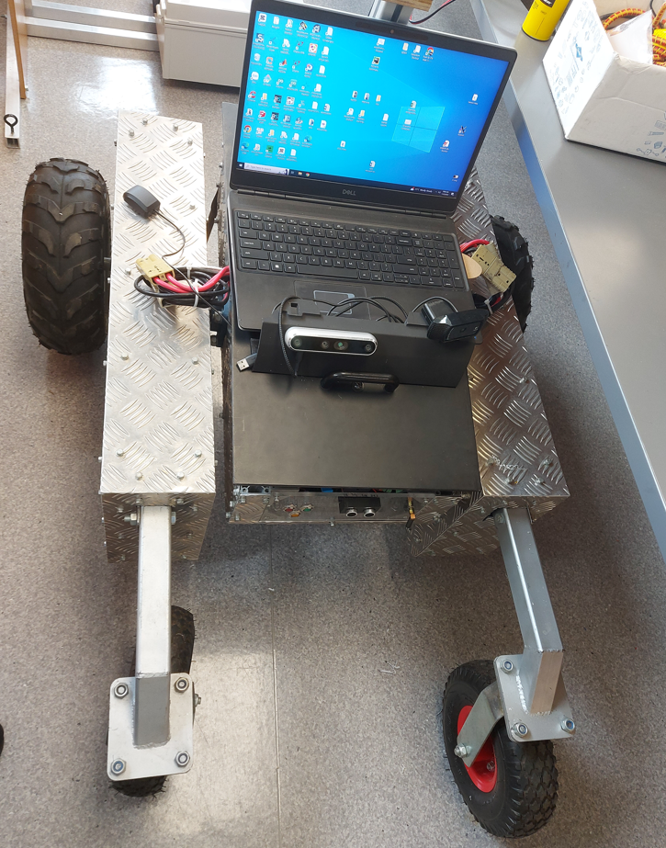
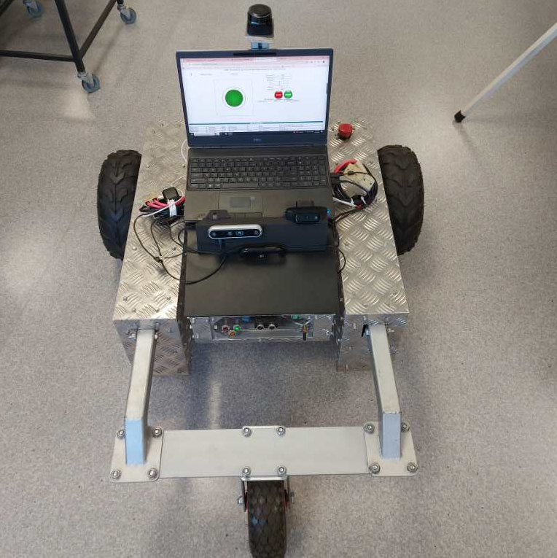

Slide 26
Future Improvements & Applications
Enhance the program of Automatic Control following the navigation plan by GPS
Improve Dataset quality in the control over the Traffic Sign
PID control for motor speed and position improvement
Increase Security for website and Robot Data MYSQL
MySQL data stored on the RPI connection is still unresolved.
Control an automatically moving car using Rplidar Data
Correct the Arduino program to read the PWM Motor current

Slide 27
Conclusion
IoT allows real-time control & monitoring of robot cars.
The combination of sensors, microcontrollers, and cloud connectivity enables autonomous operation.
The combination of IOT and AI Image processing can be a future technology
IoT-based robot cars with AI are shaping the future of automation.

Slide 28
Q&A
ANY QUESTION?

